Slide 1
Success and Stress Management in Middle School
HMS School Counseling Department

Slide 3
What is your vision for long term success?
What do you want your child to be able to do in most settings—whether it is in
school,
career,
college, and
relationships?
What are some examples?
Notes:
What is your vision for long term success?
What are things you want your child to be able to do in most situations, whether it is a job or schooling?
What is it that will prepare your child to be successful in school, relationships, and a career?
Each parent has their own version of what success for their child is. What are some examples you have heard?

Slide 4
Larger Goals for Long Term Success
I want all kids to know…
Who you are
How to handle yourself when you are not under supervision
How to handle yourself when you get in over your head
How to problem solve so you can make corrections, restitution, or decide on a new path.

Slide 5
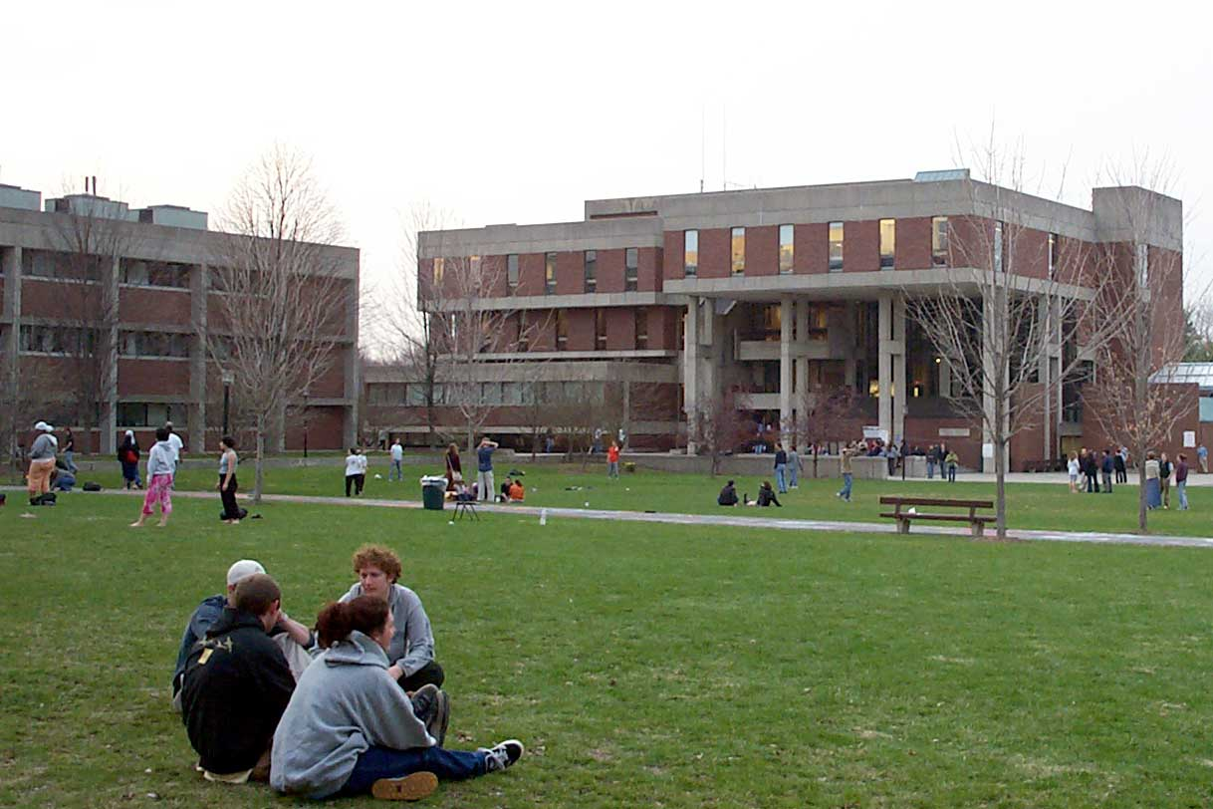
What colleges want their students to be able to do:
Get along well with others.
Speak up when you don’t understand.
Do your studies every day—without expecting anyone to check on you.
Have safe fun.
Turn in complete work on time.
Be creative!
Show up on time, every day.
Work hard even when you are not in class.
Notes:
Research, listening, and ponderings have brought me to these lists of what a college wants and what an employer wants a person to show great competence:

Slide 6
What employers want from their workers:
Get along well with others.
Try to figure out problems on your own first, but speak up before you do something really costly.
Do quality work even when no one is checking.
Turn in completed work on time.
Be creative!
Show up on time, every day.
Have a positive attitude.
(What you put out, you will receive.)

Slide 7
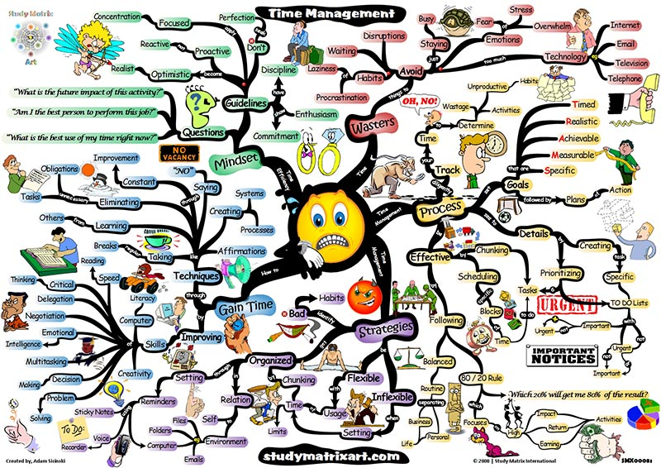
3 Important Skills to Master :
1. Time Management
Map out weekly schedule
Use of planner
Teacher websites
Study Sessions

Slide 8
3 Important Skills to Master :
2. How to Study
1. Review class notes
2. Start studying 5 nights before an exam
3. Attend help sessions- come with questions for the teacher (esp. for Math)

Slide 9
3 Important Skills to Master:
3. Modeling self -care habits
Set realistic goals for yourself
Sleep it's important
Eat healthy and balanced meals
Exercise
Do what you enjoy doing
Practice relaxation techniques
Get support from relationships

Slide 10
Model Resilience. The sky is falling… And there is a tornado, too!
When we act like the sky is falling, our children have no alternatives but to take the cue from us and re-act like the sky is falling.
Show yourself taking a breath.
Show yourself as needing to respond in a few minutes.
Show yourself as “I am getting more upset the more I think about this so I need to stop talking right now.”
Notes:
How to model self control when “The Sky is Falling”

Slide 11
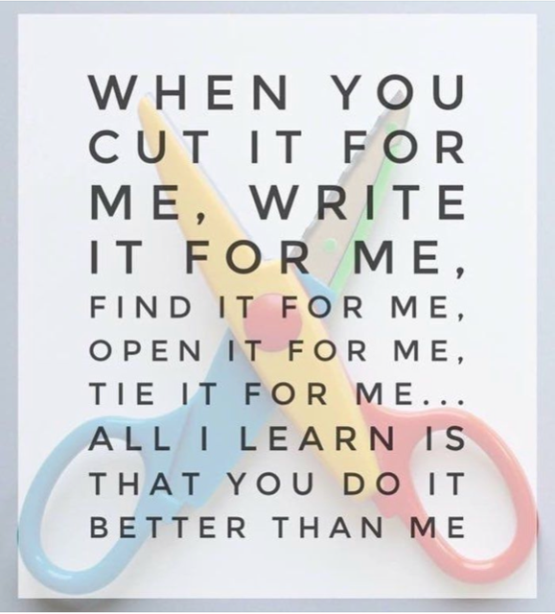
Do not join them in the tornado!
Even though you know the way out and can get them out of it soooo much faster if they would just let you handle it.
Do not join them in the tornado. Coach them on what they can do to handle it themselves.
Notes:
What will they do? You will start to get texts and phone calls from the bathroom about things that were forgotten. Make your first question a calm and loving, “What do you want to do about that?” Give them an opportunity to problem solve it. Are they going to approach the teacher? Are they going to take the L for today and turn it in tomorrow? What are they going to do? Let them talk it though. Let them say what they think will be around that corner when they make those choices. Is that something they can handle? Do they need more ideas?

Slide 12
When you get the call from the bathroom…
Oh, Babe. What a bummer.
What do you want to do about that?
What will happen if you do/don’t do that?
Do you think you can handle it?
Do you want any other ideas?
I’m proud of you for figuring something out. See you later.

Slide 13
It Takes a Village! We are all in this together☺.

Slide 14
Books for inspiration:
Parenting with Love and Logic, by Foster Cline and Jim Fey
How to talk so children will listen and listen so children will talk, by Farber and Mazlish
The Gift of Failure: How the Best Parents Learn to Let Go So Their Children Can Succeed, by Jessica Lahey
Bloom: 50 Things to Say, Think, and Do with Anxious, Angry, and Over-the-Top Kids, by Lynne Kenney

